Slide 1
Project Update….

Slide 2
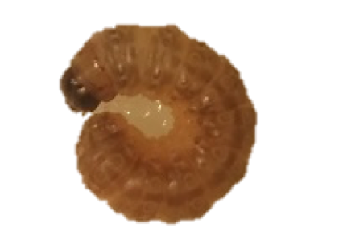
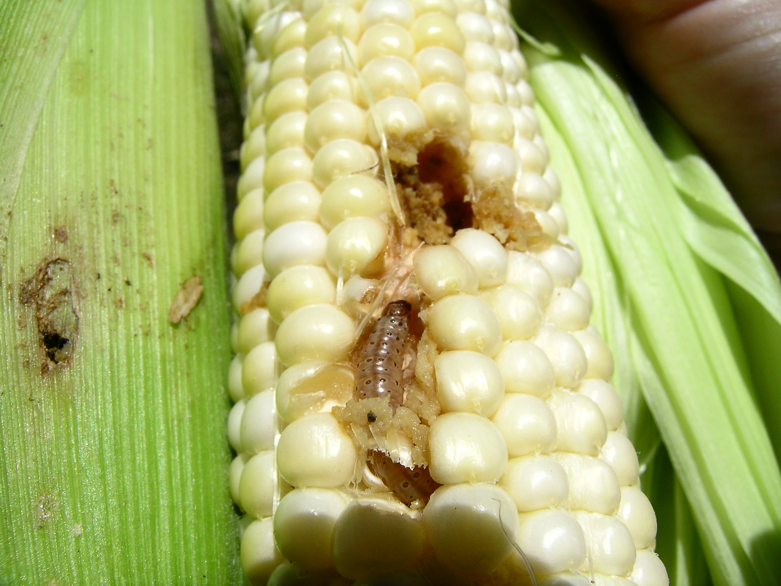
?
Shared Developmental Stage
Diapause
Non-diapause
Diapause and non diapause larvae enter wandering stage
Wandering stage larvae terminate feeding
Stored resources at their peak during wandering stage
WANDERING STAGE

Slide 3
Surveillance Population
Finding wanders by tracking a population subset

Slide 4
11
10
10

Slide 5
6
6

Slide 6
10
11
10

Slide 7
6
6
6
6

Slide 8
3
9
10
8

Slide 9
6
6
6

Slide 10
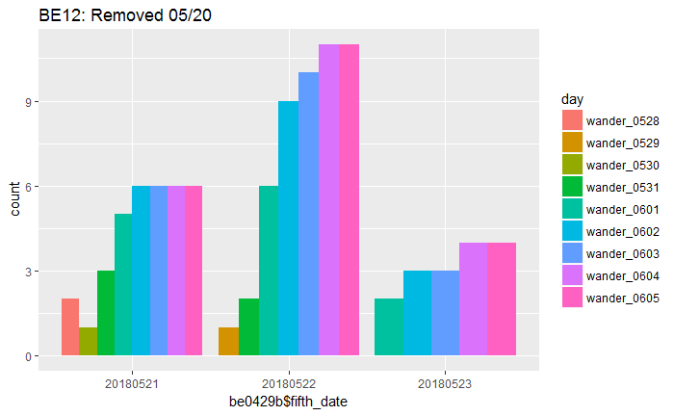
13
12
12

Slide 11
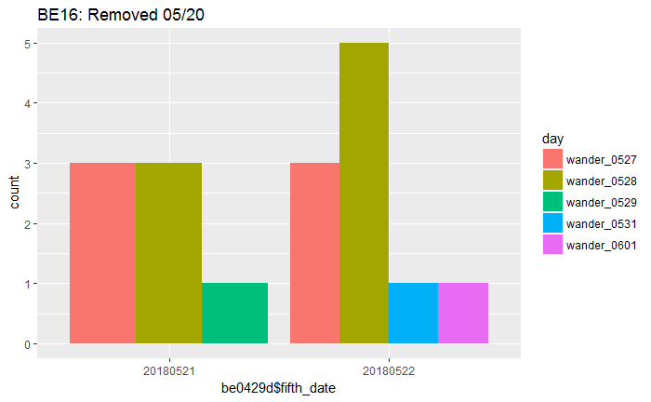
6
6

Slide 12
Experimental Design
Finding wanders

Slide 13
Sampling Design
Plot: long day (16:8) and short day (12:12)
Subplot: BE-strain and UZ-strain
Replicates sampled: “BE 0314”, “BE 0320”, and “UZ 0302”
”UZ 0412” and ”BE 0429” samples pending
Larvae reared in aggregate until late 4th instar
Progression through 5th instar tracked using a “surveillance” population between 24-48 larvae
Day one of 5th instar
Wandering day
Diapause day 15, 20, 30, and 45
All larvae starved for 30mins before sampling and to determine wandering
 | Experimental Design Goal
 | Diapause (12:12) |  | Non Diapause (16:8)
 | BE | UZ | BE | UZ
5th Day 1 | 20 Larvae | 20 Larvae | 20 Larvae | 20 Larvae
Wander Day 1 | 20 Larvae | 20 Larvae | 20 Larvae | 20 Larvae
Wander Day 15 | 20 Larvae | 20 Larvae
Wander Day 20 | 20 Larvae | 20 Larvae
Wander Day 30 | 20 Larvae | 20 Larvae
Wander Day 45 | 20 Larvae | 20 Larvae

Slide 14
Collected Data
Wet Mass, Dry Mass, Lean Mass, and Lipid Mass

Slide 15
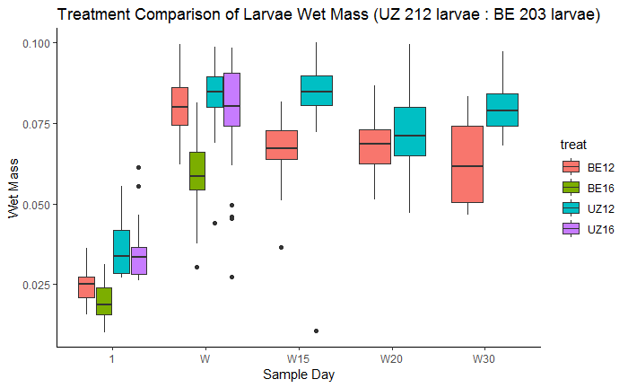

Slide 16
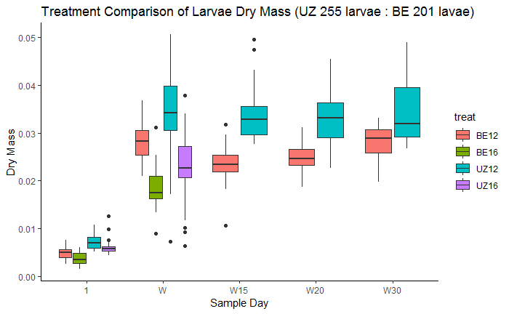

Slide 17
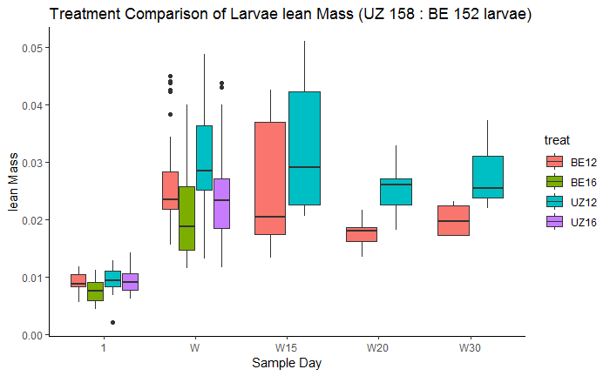

Slide 18
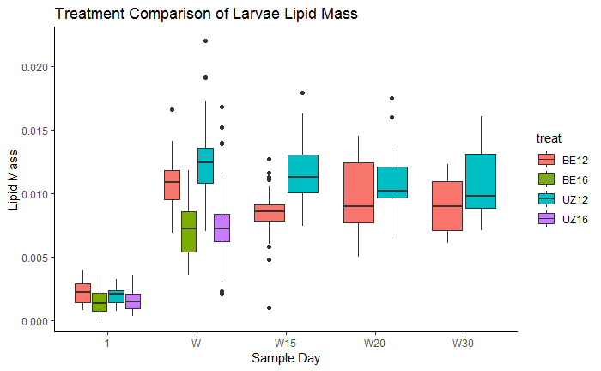

Slide 19
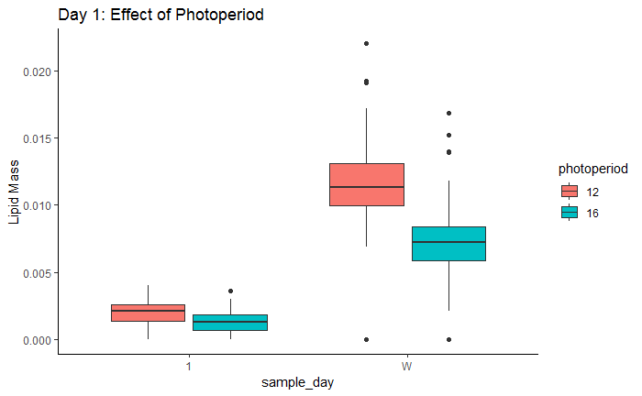
Treatment Difference Between Strain
How does lipid accumulation compare across the 5th instar?
a
b
Day One
BE 16:8
UZ 16:8
Wandering
BE 16:8
UZ 16:8
a
b

Slide 20
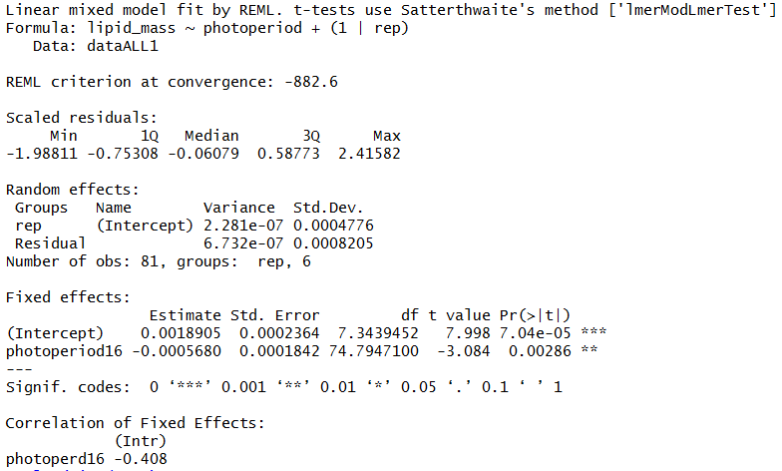
Treatment Difference on Day 1

Slide 21
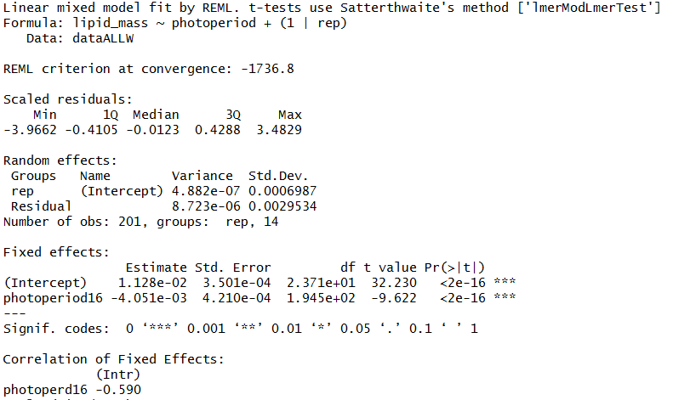
Treatment Difference on Wandering Day

Slide 22
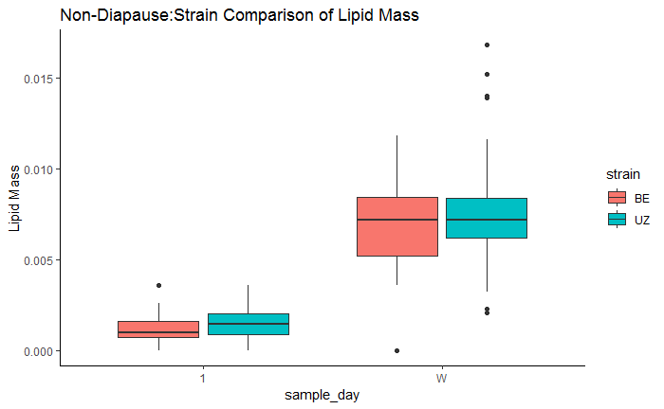
Strain Difference Within Non Diapause Treatment
How does lipid accumulation compare across the 5th instar inside the non diapause treatment?
a
b
Day One
BE 16:8
UZ 16:8
Wandering
BE 16:8
UZ 16:8
a
a

Slide 23
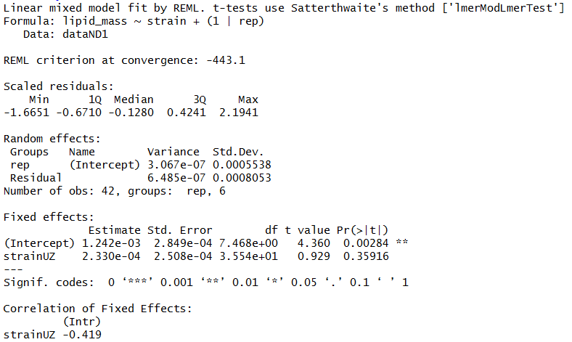
Linear Mixed Model for Day 1

Slide 24
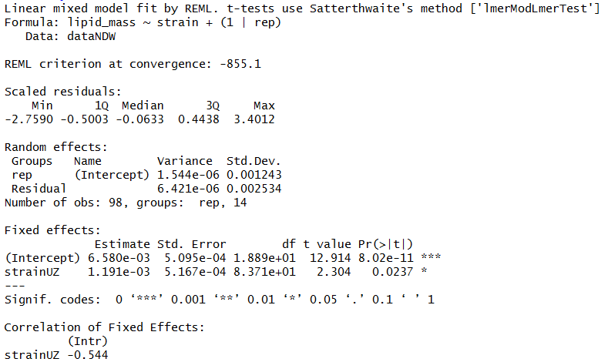
Linear Mixed Model on Wandering Day

Slide 25
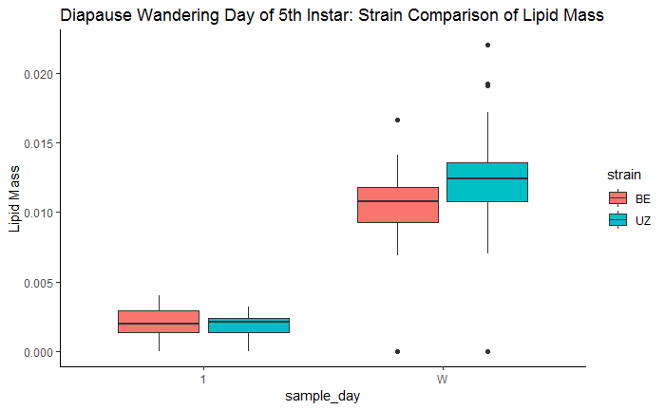
Strain Difference Within Diapause Treatment
How does lipid accumulation compare during the 5th instar inside the diapause treatment?
a
b
Day One
BE 12:12
UZ 12:12
Wandering
BE 12:12
UZ 12:12
a
a

Slide 26
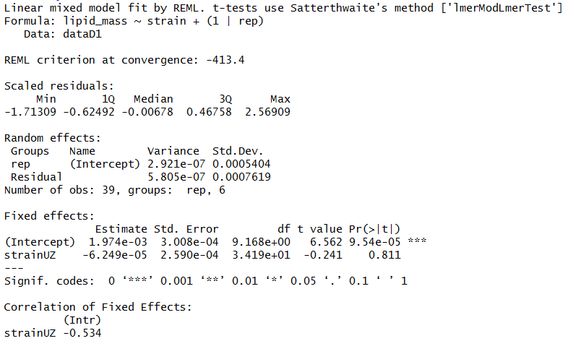
Linear Mixed Model for Day 1

Slide 27
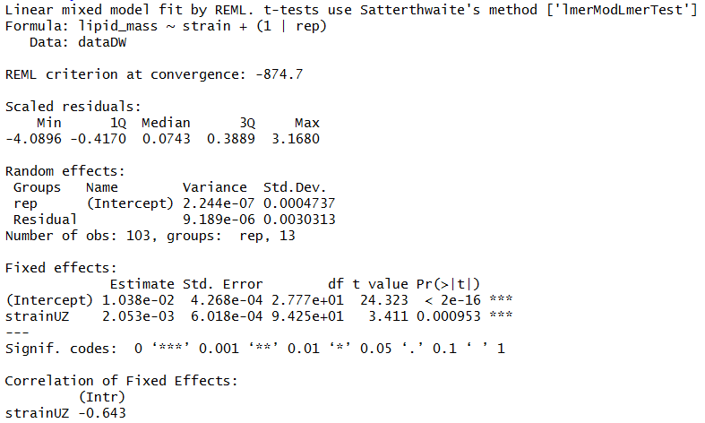
Linear Mixed Model for Day 1

Slide 28
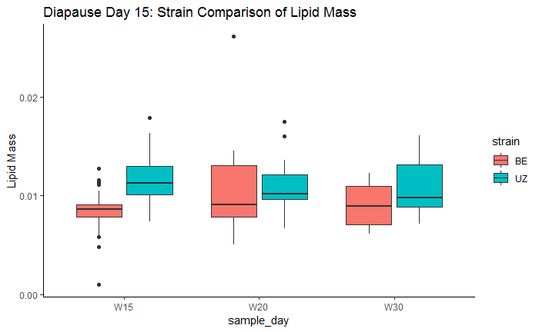
Strain Difference During Diapause
How does lipid depletion compare during diapause?
b
a
a
Day One
BE 12:12
UZ 12:12
Wandering
BE 12:12
UZ 12:12
Diapause Day 15
BE 12:12
UZ 12:12
Diapause Day 20
BE 12:12
UZ 12:12
Diapause Day 30
BE 12:12
UZ 12:12
a
a
a

Slide 32
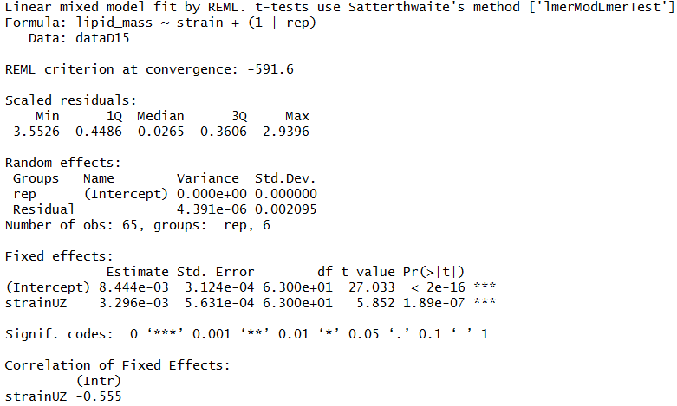
Strain Difference Between Treatments on Day W15

Slide 33
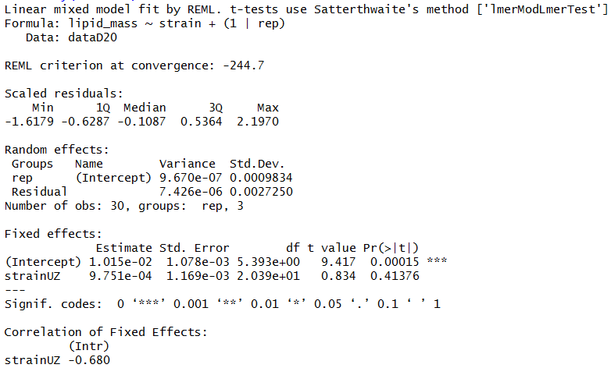
Strain Difference Between Treatments on Day W20

Slide 34
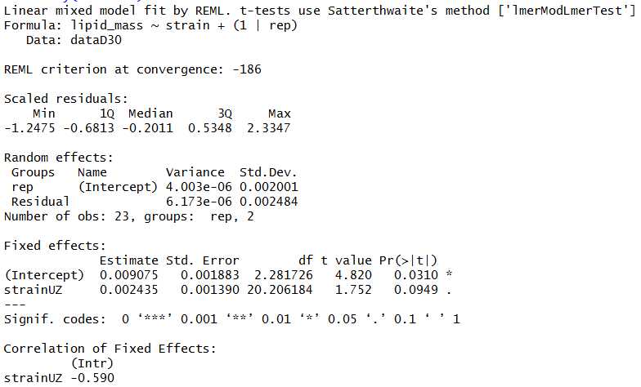
Strain Difference Between Treatments on Day W30

Slide 35
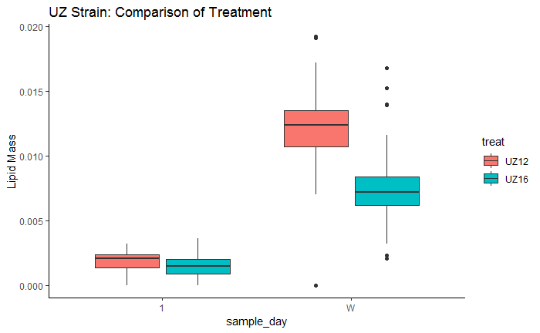
UZ Strain: Treatment Difference Within Strain
How does lipid accumulation compare within the UZ strain across the 5th instar?
a
b
Day One
UZ 12:12
UZ 16:8
Wandering
UZ 12:12
UZ 16:8
a
a

Slide 36
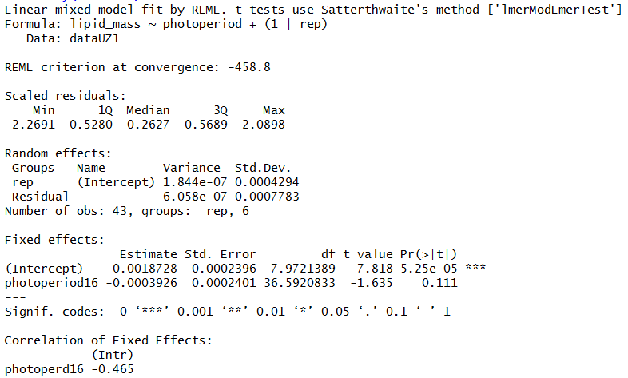
Treatment Difference Within UZ on Day 1

Slide 37

Treatment Difference Within UZ on Wandering Day

Slide 38
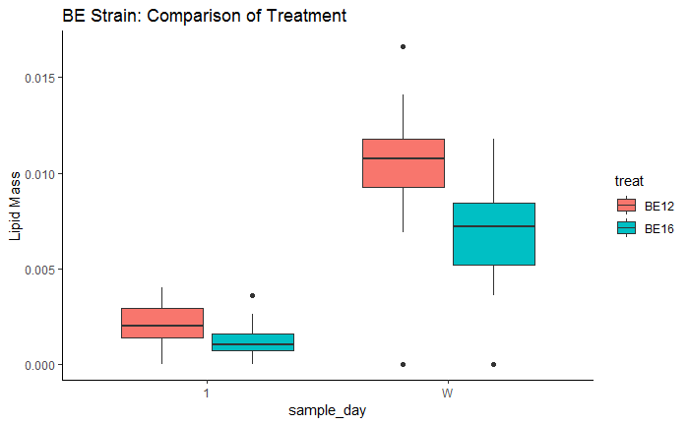
BE Strain: Treatment Difference Within Strain
How does lipid accumulation compare within the BE strain during the 5th instar?
a
b
Day One
UZ 12:12
UZ 16:8
Wandering
UZ 12:12
UZ 16:8
a
b

Slide 39
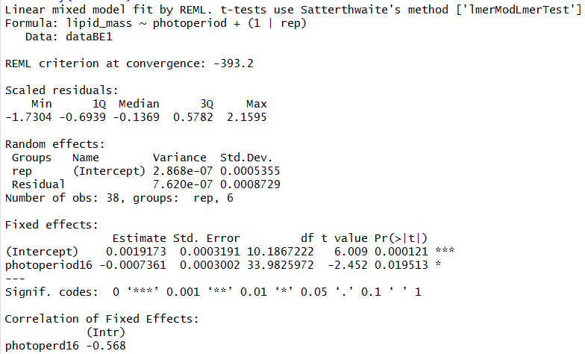
Treatment Difference Within BE on Day 1

Slide 40
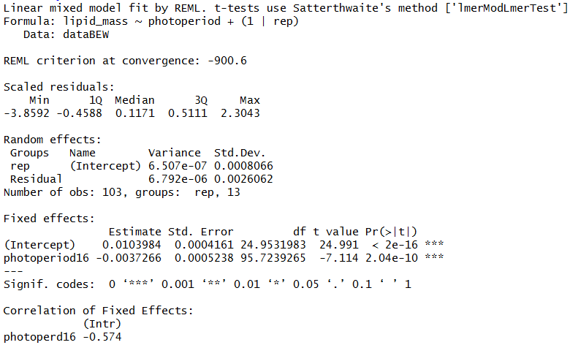
Treatment Difference Within BE on Wandering Day

Slide 41
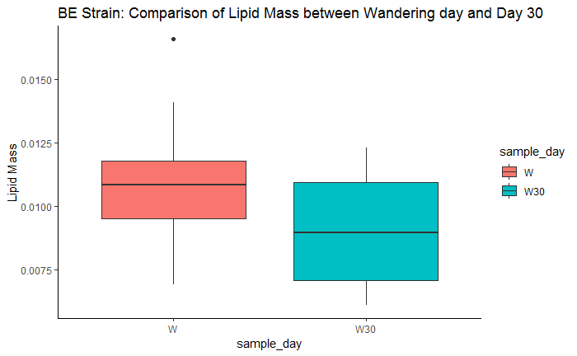
BE Strain: Difference Between Wandering Day and W30
How does lipid accumulation compare between the wandering day and 30 days after wandering?
a
a
Wandering Day
BE 12:12
Diapause Day 30
BE 12:12

Slide 42
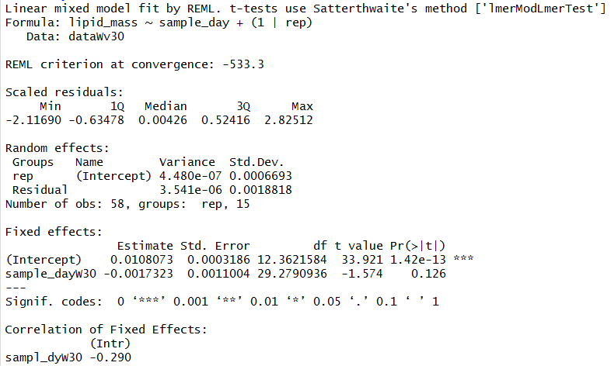
BE Strain: Difference Between Sample Days W and W30

Slide 43
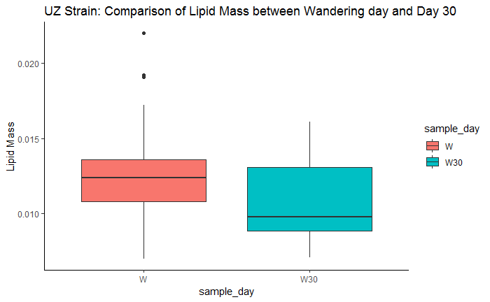
UZ Strain: Difference Between Wandering Day and W30
How does lipid accumulation compare between the wandering day and 30 days after wandering?
a
a
Wandering Day
UZ 12:12
Diapause Day 30
UZ 12:12

Slide 44
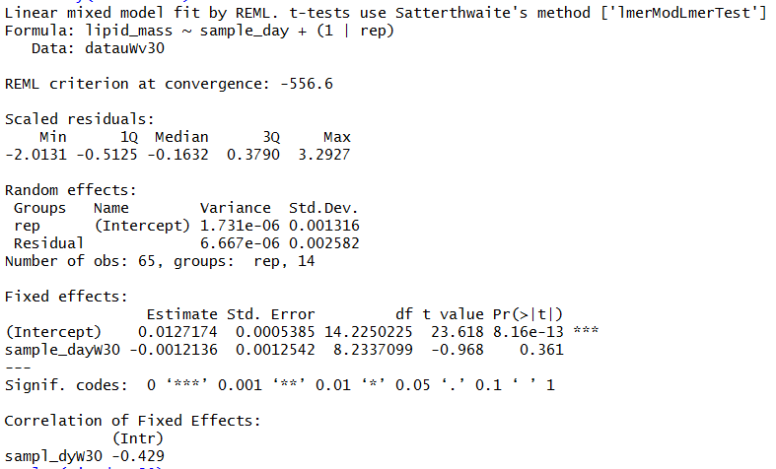

Slide 45
Respirometry

Slide 50
PULSE EXPERIMENT
Larvae samples taken once during wandering stage

Slide 51
Sampling Design
Plot: long day (16:8) and short day (12:12)
Subplot: BE-strain and UZ-strain
Replicates sampled: ”June”, “July”, “August”, and “September”
Larvae reared in aggregate until late 4th instar
All larvae starved for 1hr before sampling and to determine wandering
 | Experimental Design Goal
 | Diapause (12:12) |  | Non Diapause (16:8)
 | BE | UZ | BE | UZ
Wander Day 1 | 30 Larvae | 30 Larvae | 30 Larvae | 30 Larvae

